Slide 1
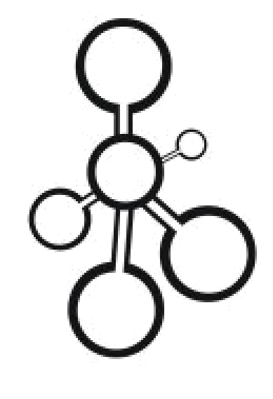
Data Structures
Midterm Exam Guide

Slide 2

About the Midterm Exam
Tuesday, Apr 2, lecture time.
Total time: 80 minutes
Questions
(Weight: 30%) 15 Multiple Choice Questions (General knowledge questions).
3 Questions on these topics (Linked Lists, Stacks, Queues, Recursion)
(Weight: 40%) 2 programming questions. You have to write code (One question is on recursion and linked lists).
(Weight: 20%) Last question is a pseudo-code question algorithm.
(Weight: 10%) A question on what data structure you would use for some requirements.

Slide 3
Time Management in the Exam
Focus on the questions you know very well.
Leave the ones you are not sure of till you are done with the ones you know.
If you are not so sure about the answer, write what you know.

Slide 4
How to Study (Priorities)
Tasks, Quizzes.
Slides
The Summaries of the chapters in the textbook.
Projects (e.g. supermarket example)
Assignments.

